Slide 1
Master Thesis - Update
Yun Shang
yun.shang@fau.de
Chair of Multimedia Communications and Signal Processing

Slide 2
CONTENT
▶ Tools Used:
1. Software Encoder: x265 and Hardware Encoder: NVIDIA Jetson Orin NX (8GB)
2. Dataset- AOM Class 1 & 2, 8-bit video sequence
3. VQ Analyzer
▶ the first frames for each video sequence, SWEnc preset(ultrafast, superfast, veryfast, faster, fast, medium) and HWEnc preset(slow,medium,fast,ultrafast)
▶ QP value- SWEnc&HWEnc(22, 27, 32, 37)

Slide 3
PU Block Size
VQ Stats | SW Preset |  |  |  |  |  | HW Preset
 | medium | fast | faster | veryfast | superfast | ultrafast | slow | medium | fast | ultrafast
PU sizes: 64x64 | 0 | 0 | 0 | 0 | 0 | 0 | 0 | 0 | 0 | 0
PU sizes: 64x48 | 0 | 0 | 0 | 0 | 0 | 0 | 0 | 0 | 0 | 0
PU sizes: 64x32 | 0 | 0 | 0 | 0 | 0 | 0 | 0 | 0 | 0 | 0
PU sizes: 64x16 | 0 | 0 | 0 | 0 | 0 | 0 | 0 | 0 | 0 | 0
PU sizes: 48x64 | 0 | 0 | 0 | 0 | 0 | 0 | 0 | 0 | 0 | 0
PU sizes: 32x64 | 0 | 0 | 0 | 0 | 0 | 0 | 0 | 0 | 0 | 0
PU sizes: 32x32 | 226516 | 231084 | 231084 | 231096 | 236998 | 264983 | 237175 | 237175 | 260213 | 250390
PU sizes: 32x24 | 0 | 0 | 0 | 0 | 0 | 0 | 0 | 0 | 0 | 0
PU sizes: 32x16 | 0 | 0 | 0 | 0 | 0 | 0 | 0 | 0 | 0 | 0
PU sizes: 32x8 | 0 | 0 | 0 | 0 | 0 | 0 | 0 | 0 | 0 | 0
PU sizes: 24x32 | 0 | 0 | 0 | 0 | 0 | 0 | 0 | 0 | 0 | 0
PU sizes: 16x64 | 0 | 0 | 0 | 0 | 0 | 0 | 0 | 0 | 0 | 0
PU sizes: 16x32 | 0 | 0 | 0 | 0 | 0 | 0 | 0 | 0 | 0 | 0
PU sizes: 16x16 | 469293 | 446355 | 446355 | 446333 | 430898 | 694948 | 512516 | 512512 | 513219 | 449482
PU sizes: 16x12 | 0 | 0 | 0 | 0 | 0 | 0 | 0 | 0 | 0 | 0
PU sizes: 16x8 | 0 | 0 | 0 | 0 | 0 | 0 | 0 | 0 | 0 | 0
PU sizes: 16x4 | 0 | 0 | 0 | 0 | 0 | 0 | 0 | 0 | 0 | 0
PU sizes: 12x16 | 0 | 0 | 0 | 0 | 0 | 0 | 0 | 0 | 0 | 0
PU sizes: 8x32 | 0 | 0 | 0 | 0 | 0 | 0 | 0 | 0 | 0 | 0
PU sizes: 8x16 | 0 | 0 | 0 | 0 | 0 | 0 | 0 | 0 | 0 | 0
PU sizes: 8x8 | 966658 | 996722 | 996722 | 996653 | 987371 | 0 | 668530 | 668536 | 833956 | 1246072
PU sizes: 8x4 | 0 | 0 | 0 | 0 | 0 | 0 | 0 | 0 | 0 | 0
PU sizes: 4x16 | 0 | 0 | 0 | 0 | 0 | 0 | 0 | 0 | 0 | 0
PU sizes: 4x8 | 0 | 0 | 0 | 0 | 0 | 0 | 0 | 0 | 0 | 0
PU sizes: 4x4 | 2121256 | 2075656 | 2075656 | 2075516 | 1981876 | 0 | 2147384 | 2147424 | 0 | 0

Slide 4
Intra Luma Modes
VQ Stats | SW Preset |  |  |  |  |  | HW Preset
 | medium | fast | faster | veryfast | superfast | ultrafast | slow | medium | fast | ultrafast
Intra luma modes: 0 | 1194704 | 1161053 | 1161053 | 1160970 | 1109026 | 226071 | 908746 | 908755 | 460769 | 684000
Intra luma modes: 1 | 635099 | 614491 | 614491 | 614458 | 591388 | 164741 | 502523 | 502525 | 312504 | 437061
Intra luma modes: 2 | 60607 | 60501 | 60501 | 60500 | 58328 | 12147 | 96654 | 96656 | 60218 | 109617
Intra luma modes: 3 | 58230 | 58659 | 58659 | 58647 | 57662 | 10947 | 86497 | 86497 | 32574 | 0
Intra luma modes: 4 | 57477 | 58002 | 58002 | 57994 | 57248 | 12997 | 72765 | 72767 | 30704 | 67233
Intra luma modes: 5 | 67966 | 70159 | 70159 | 70158 | 70126 | 15690 | 85088 | 85088 | 38612 | 0
Intra luma modes: 6 | 93450 | 93728 | 93728 | 93724 | 92108 | 15361 | 109964 | 109964 | 44992 | 98622
Intra luma modes: 7 | 104843 | 103896 | 103896 | 103885 | 98894 | 18845 | 122930 | 122931 | 53241 | 0
Intra luma modes: 8 | 141968 | 139951 | 139951 | 139956 | 135536 | 25690 | 157557 | 157557 | 65770 | 151587
Intra luma modes: 9 | 302191 | 297631 | 297631 | 297626 | 280950 | 25928 | 258477 | 258484 | 88245 | 0
Intra luma modes: 10 | 640632 | 631166 | 631166 | 631160 | 608205 | 48927 | 550431 | 550433 | 140044 | 286919
Intra luma modes: 11 | 286654 | 282263 | 282263 | 282244 | 267391 | 24802 | 243453 | 243453 | 88896 | 0
Intra luma modes: 12 | 159038 | 156894 | 156894 | 156887 | 153663 | 27517 | 171962 | 171965 | 74495 | 169516
Intra luma modes: 13 | 112990 | 113932 | 113932 | 113921 | 109098 | 17033 | 134372 | 134373 | 51408 | 0
Intra luma modes: 14 | 87194 | 87048 | 87048 | 87049 | 84205 | 11841 | 104918 | 104918 | 38531 | 94750
Intra luma modes: 15 | 70602 | 71064 | 71064 | 71054 | 69857 | 10367 | 87991 | 87993 | 35001 | 0
Intra luma modes: 16 | 63380 | 63214 | 63214 | 63206 | 62371 | 9861 | 78807 | 78809 | 28036 | 68453
Intra luma modes: 17 | 70672 | 70504 | 70504 | 70512 | 68512 | 8576 | 88489 | 88489 | 22563 | 0
Intra luma modes: 18 | 59281 | 60490 | 60490 | 60494 | 58642 | 8564 | 66730 | 66730 | 47157 | 95408
Intra luma modes: 19 | 67948 | 67480 | 67480 | 67440 | 66221 | 8581 | 85651 | 85653 | 21570 | 0
Intra luma modes: 20 | 58162 | 58874 | 58874 | 58869 | 57012 | 8646 | 73980 | 73980 | 25598 | 63672
Intra luma modes: 21 | 64358 | 64191 | 64191 | 64173 | 62676 | 9778 | 79519 | 79521 | 32167 | 0
Intra luma modes: 22 | 75124 | 75286 | 75286 | 75284 | 72172 | 10901 | 88415 | 88415 | 33199 | 81116
Intra luma modes: 23 | 80462 | 80573 | 80573 | 80558 | 78111 | 13244 | 100451 | 100451 | 40476 | 0
Intra luma modes: 24 | 88527 | 89152 | 89152 | 89138 | 86400 | 17252 | 106419 | 106417 | 46573 | 106754
Intra luma modes: 25 | 109172 | 108236 | 108236 | 108234 | 103337 | 16707 | 112232 | 112232 | 57785 | 0
Intra luma modes: 26 | 448510 | 438662 | 438662 | 438678 | 431491 | 62802 | 346539 | 346547 | 131079 | 298232
Intra luma modes: 27 | 120721 | 120018 | 120018 | 120010 | 113493 | 19596 | 119817 | 119816 | 60313 | 0
Intra luma modes: 28 | 96685 | 97286 | 97286 | 97276 | 93427 | 20014 | 110965 | 110970 | 48353 | 117580
Intra luma modes: 29 | 86611 | 87806 | 87806 | 87790 | 83765 | 16229 | 104925 | 104925 | 43847 | 0
Intra luma modes: 30 | 83680 | 82991 | 82991 | 82992 | 81064 | 13730 | 98598 | 98600 | 37515 | 88998
Intra luma modes: 31 | 65896 | 65912 | 65912 | 65905 | 64899 | 12673 | 83171 | 83182 | 34134 | 0
Intra luma modes: 32 | 57705 | 57513 | 57513 | 57492 | 56813 | 11140 | 74124 | 74131 | 28256 | 68136
Intra luma modes: 33 | 67100 | 68266 | 68266 | 68255 | 66928 | 11091 | 100072 | 100087 | 32043 | 0
Intra luma modes: 34 | 67340 | 68581 | 68581 | 68575 | 68000 | 11642 | 99757 | 99757 | 54676 | 104362

Slide 5
Intra Chroma Modes
VQ Stats | SW Preset |  |  |  |  |  | HW Preset
 | medium | fast | faster | veryfast | superfast | ultrafast | slow | medium | fast | ultrafast
Intra chroma modes: Diag | 31604 | 29797 | 29797 | 29795 | 28565 | 14346 | 41286 | 41286 | 22856 | 26655
Intra chroma modes: LM | 0 | 0 | 0 | 0 | 0 | 0 | 0 | 0 | 0 | 0
Intra chroma modes: DM | 1737260 | 1746622 | 1746622 | 1746542 | 1711978 | 696841 | 1171526 | 1171536 | 530407 | 550303
Intra chroma modes: DC | 96358 | 96028 | 96028 | 96018 | 94979 | 66059 | 171505 | 171506 | 111527 | 112199
Intra chroma modes: Planar | 146302 | 143849 | 143849 | 143833 | 141936 | 88800 | 218651 | 218652 | 117985 | 116631
Intra chroma modes: Horiz | 102122 | 99586 | 99586 | 99584 | 97634 | 50536 | 193958 | 193958 | 107873 | 111476
Intra chroma modes: Vert | 79135 | 77193 | 77193 | 77189 | 75644 | 43349 | 158141 | 158141 | 91273 | 94126

Slide 6
TU Block Size
VQ Stats | SW Preset |  |  |  |  |  | HW Preset
 | medium | fast | faster | veryfast | superfast | ultrafast | slow | medium | fast | ultrafast
TU sizes: 32x32 | 184497 | 187926 | 187926 | 187934 | 194518 | 222093 | 186262 | 186262 | 209521 | 200142
TU sizes: 16x16 | 564905 | 553017 | 553017 | 552975 | 548572 | 854979 | 629525 | 629522 | 675697 | 595503
TU sizes: 8x8 | 1018106 | 1024736 | 1024736 | 1024664 | 1012585 | 548881 | 878140 | 878137 | 1136647 | 1354256
TU sizes: 4x4 | 2481797 | 2426222 | 2426222 | 2426113 | 2334174 | 0 | 2477131 | 2477156 | 567427 | 741510

Slide 7
Transform Types
VQ Stats | SW Preset |  |  |  |  |  | HW Preset
 | medium | fast | faster | veryfast | superfast | ultrafast | slow | medium | fast | ultrafast
DCT | 0 | 0 | 0 | 0 | 0 | 120 | 3 | 3 | 5760 | 5760
DST | 120 | 120 | 120 | 120 | 120 | 0 | 117 | 117 | 0 | 0

Slide 8
TU Depth
VQ Stats | SW Preset |  |  |  |  |  | HW Preset
 | medium | fast | faster | veryfast | superfast | ultrafast | slow | medium | fast | ultrafast
TU depth (CU 64): 0 | 0 | 0 | 0 | 0 | 0 | 0 | 0 | 0 | 0 | 0
TU depth (CU 64): 1 | 0 | 0 | 0 | 0 | 0 | 0 | 0 | 0 | 0 | 0
TU depth (CU 64): 2 | 0 | 0 | 0 | 0 | 0 | 0 | 0 | 0 | 0 | 0
TU depth (CU 64): 3 | 0 | 0 | 0 | 0 | 0 | 0 | 0 | 0 | 0 | 0
TU depth (CU 64): 4 | 0 | 0 | 0 | 0 | 0 | 0 | 0 | 0 | 0 | 0
TU depth (CU 32): 0 | 184497 | 187926 | 187926 | 187934 | 194518 | 222093 | 186262 | 186262 | 209521 | 200142
TU depth (CU 32): 1 | 0 | 0 | 0 | 0 | 0 | 0 | 0 | 0 | 0 | 0
TU depth (CU 32): 2 | 0 | 0 | 0 | 0 | 0 | 0 | 0 | 0 | 0 | 0
TU depth (CU 32): 3 | 0 | 0 | 0 | 0 | 0 | 0 | 0 | 0 | 0 | 0
TU depth (CU 16): 0 | 373653 | 357557 | 357557 | 357535 | 345024 | 599924 | 451140 | 451136 | 463284 | 395167
TU depth (CU 16): 1 | 0 | 0 | 0 | 0 | 0 | 0 | 0 | 0 | 727705 | 1015084
TU depth (CU 16): 2 | 0 | 0 | 0 | 0 | 0 | 0 | 0 | 0 | 0 | 0
TU depth (CU 8): 0 | 745810 | 756443 | 756443 | 756400 | 752111 | 0 | 544791 | 544795 | 0 | 0
TU depth (CU 8): 1 | 1617306 | 1574827 | 1574827 | 1574773 | 1494503 | 0 | 1668135 | 1668157 | 0 | 0

Slide 9
SCC Tools (IntraBC, Palette)
VQ Stats | SW Preset |  |  |  |  |  | HW Preset
 | medium | fast | faster | veryfast | superfast | ultrafast | slow | medium | fast | ultrafast
Inter PU type: IBC | 0 | 0 | 0 | 0 | 0 | 0 | 0 | 0 | 0 | 0
Pred mode: Palette | 0 | 0 | 0 | 0 | 0 | 0 | 0 | 0 | 0 | 0
Intra PU type: Palette | 0 | 0 | 0 | 0 | 0 | 0 | 0 | 0 | 0 | 0

Slide 10
Block Partitioning : Partition Schemes
VQ Stats | SW Preset |  |  |  |  |  | HW Preset
 | medium | fast | faster | veryfast | superfast | ultrafast | slow | medium | fast | ultrafast
Partition types: 2Nx2N | 1662467 | 1674161 | 1674161 | 1674082 | 1655267 | 959931 | 1418221 | 1418223 | 773432 | 699872
Partition types: 2NxN | 0 | 0 | 0 | 0 | 0 | 0 | 0 | 0 | 0 | 0
Partition types: Nx2N | 0 | 0 | 0 | 0 | 0 | 0 | 0 | 0 | 0 | 0
Partition types: NxN | 530314 | 518914 | 518914 | 518879 | 495469 | 0 | 536846 | 536856 | 208489 | 311518
Partition types: 2NxnU | 0 | 0 | 0 | 0 | 0 | 0 | 0 | 0 | 0 | 0
Partition types: 2NxnD | 0 | 0 | 0 | 0 | 0 | 0 | 0 | 0 | 0 | 0
Partition types: nLx2N | 0 | 0 | 0 | 0 | 0 | 0 | 0 | 0 | 0 | 0
Partition types: nRx2N | 0 | 0 | 0 | 0 | 0 | 0 | 0 | 0 | 0 | 0

Slide 11
Post processing filters:Deblocking Filter
VQ Stats | SW Preset |  |  |  |  |  | HW Preset
 | medium | fast | faster | veryfast | superfast | ultrafast | slow | medium | fast | ultrafast
Deblocking luma vertical: No deblock | 1140682 | 1133279 | 1133279 | 1133217 | 1124332 | 634200 | 0 | 0 | 1062481 | 1080957
Deblocking luma vertical: Luma strong | 1637639 | 1631548 | 1631548 | 1631550 | 1611049 | 1369642 | 0 | 0 | 1259756 | 1380349
Deblocking luma vertical: Luma weak | 3862123 | 3857817 | 3857817 | 3857645 | 3807115 | 2852910 | 0 | 0 | 3437247 | 3788878

Slide 12
Post processing filters:SAO Filter
VQ Stats | SW Preset |  |  |  |  |  | HW Preset
 | medium | fast | faster | veryfast | superfast | ultrafast | slow | medium | fast | ultrafast
SAO type luma: No Operation | 47307 | 46876 | 46876 | 46879 | 0 | 0 | 303572 | 303572 | 284744 | 274806
SAO type luma: Band | 5326 | 5946 | 5946 | 5946 | 0 | 0 | 6208 | 6208 | 9782 | 8589
SAO type luma: 0-Degree Edge | 17365 | 17222 | 17222 | 17221 | 0 | 0 | 38594 | 38594 | 42425 | 46936
SAO type luma: 90-Degree Edge | 7848 | 8756 | 8756 | 8756 | 0 | 0 | 27097 | 27097 | 25767 | 26109
SAO type luma: 135-Degree Edge | 12490 | 12228 | 12228 | 12233 | 0 | 0 | 27043 | 27042 | 33648 | 36851
SAO type luma: 45-Degree Edge | 19824 | 19132 | 19132 | 19125 | 0 | 0 | 38126 | 38127 | 44274 | 47349

Slide 13
Slices
VQ Stats | SW Preset |  |  |  |  |  | HW Preset
 | medium | fast | faster | veryfast | superfast | ultrafast | slow | medium | fast | ultrafast
count | 120 | 120 | 120 | 120 | 120 | 120 | 120 | 120 | 120 | 120
mean | 1 | 1 | 1 | 1 | 1 | 1 | 1 | 1 | 1 | 1
std | 0 | 0 | 0 | 0 | 0 | 0 | 0 | 0 | 0 | 0
min | 1 | 1 | 1 | 1 | 1 | 1 | 1 | 1 | 1 | 1
25% | 1 | 1 | 1 | 1 | 1 | 1 | 1 | 1 | 1 | 1
50% | 1 | 1 | 1 | 1 | 1 | 1 | 1 | 1 | 1 | 1
75% | 1 | 1 | 1 | 1 | 1 | 1 | 1 | 1 | 1 | 1
max | 1 | 1 | 1 | 1 | 1 | 1 | 1 | 1 | 1 | 1

Slide 14

Pes Means
config | preset | Ir | Dr | Dw | I1mr | D1mr | D1mw | ILmr | DLmr | DLmw | Bc | Bcm | Bi | Bim
A | fast | 1582183333333 | 422345825632 | 197531596234 | 11426425996 | 3370542229 | 2914192122 | 855417 | 117965209 | 134319042 | 101058351481 | 8451609542 | 10459048514 | 1091677153
 | faster | 1578291666667 | 421283333333 | 196779035304 | 11496162362 | 3357378966 | 2905120485 | 838868 | 116071853 | 130915538 | 100537592355 | 8397361430 | 10414485013 | 1088359243
 | veryfast | 1578573037440 | 421556946496 | 197532830125 | 11240510972 | 3394407901 | 2930623328 | 853964 | 118510843 | 135456267 | 101479583160 | 8485630296 | 10507609054 | 1096978748
 | superfast | 1498916666667 | 402316666667 | 187712883357 | 11212730514 | 4304917426 | 2837442413 | 662559 | 76505519 | 117763503 | 95129386372 | 8274410989 | 10233197730 | 1071702595
B | fast | 1561750000000 | 416783333333 | 193722773177 | 11894363524 | 3231622868 | 2843826512 | 759553 | 106522753 | 115299681 | 98008447016 | 8169158359 | 10202840402 | 1067984389
 | faster | 1599066666667 | 426133333333 | 197163943169 | 12494495159 | 3238874716 | 2858611120 | 783003 | 107439817 | 116905731 | 98948477751 | 8252468166 | 10280017205 | 1074933831
 | veryfast | 1543775000000 | 412158333333 | 192118746712 | 11492960050 | 3224955781 | 2829460277 | 755138 | 105782968 | 115010703 | 97740965792 | 8163220403 | 10159047744 | 1061610407
 | superfast | 1496925000000 | 400275000000 | 186977791643 | 11294816942 | 4293240060 | 2769118076 | 713145 | 104988203 | 104823200 | 94341056273 | 8087937505 | 9975591602 | 1040900816

Slide 15
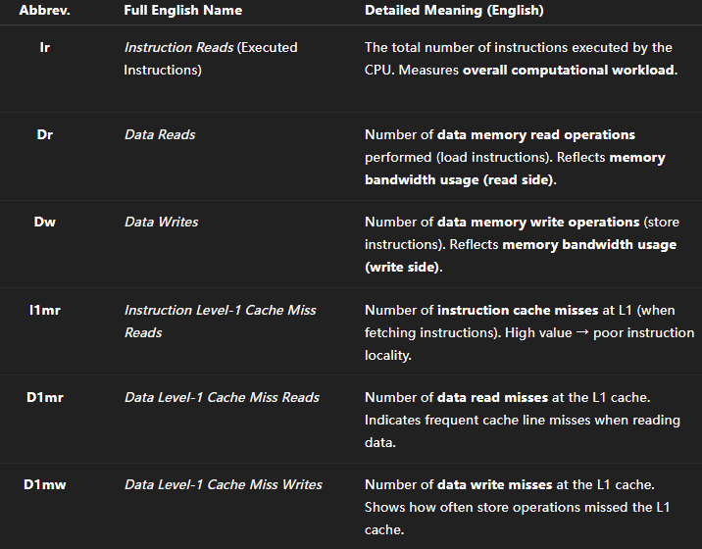
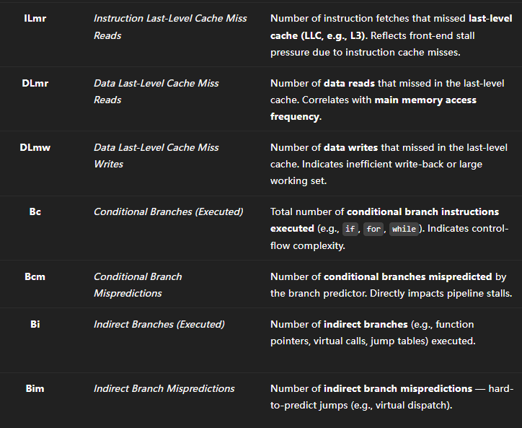
Processor Events

Slide 16
Explanation: Why superfast shows the lowest values for most PEs but the highest D1mr
In the x265 preset hierarchy (from fast → faster → veryfast → superfast), the encoder progressively disables or simplifies a large number of computational modules to achieve higher speed.
At the superfast level, most rate-distortion optimization (RDO) steps, intra-mode searches, and block-partition checks are heavily pruned or skipped.
(1) Reduced computational and memory workload
Because many algorithmic branches and searches are disabled:
Ir (executed instructions) decreases — fewer code paths are executed.
Dr/Dw (data reads/writes) decrease — less data is loaded or stored.
Branch-related events (Bc, Bi, Bcm, Bim) decrease — the control flow becomes simpler.
Higher-level cache misses (DLmr, DLmw, ILmr) usually also decrease because the overall memory footprint becomes smaller.
→ This explains why superfast exhibits the lowest counts for almost all PEs: the encoder simply “does less work.”

Slide 17
Explanation: Why superfast shows the lowest values for most PEs but the highest D1mr
(2) Why D1mr (L1 Data-Read Misses) increases instead
Although superfast executes less work overall, its data-access pattern becomes more fragmented and less cache-friendly.
Key reasons:
Weaker temporal and spatial locality.
  In fast/faster, the encoder revisits the same data (pixels, blocks) several times for RDO evaluation, so each cache line is reused multiple times → high L1 reuse.
  In superfast, early termination and pruning cause each block to be touched only once or twice, and then the encoder quickly moves to a distant region.
  → The L1 data cache sees more compulsory and capacity misses, increasing D1mr even though total reads (Dr) drop.
Less predictable access pattern for the prefetcher.
Hardware prefetchers rely on regular, sequential accesses.
Superfast’s shortened loops and irregular early-exit conditions make the access pattern less sequential, so prefetching becomes less effective.
→ Prefetch failures appear as extra L1 data-read misses.
Lower compute-to-access ratio.
Each cache line loaded in superfast performs fewer arithmetic operations before being evicted, so cache lines are replaced before full reuse.
→ The L1 miss rate (D1mr / Dr) increases, even if the total memory footprint shrinks.

Slide 18
Interaction with filtering configuration (A vs. B)
  This phenomenon is driven primarily by the preset itself, not by the SAO/Deblock switch:
  In both Config A (--no-deblock --sao) and Config B (--deblock --no-sao), the same preset mechanism applies.
  SAO tends to increase memory traffic (Dr, DLmr), while Deblock increases control-flow complexity (Bc, Bim).
  However, the superfast preset’s simplified loop structure dominates both effects, so D1mr remains the largest in both A and B.

Slide 19
Model Performance Comparison
Configuration | Model Type | Coefficient of Determination | Root Mean Square Error | Mean Absolute Percentage Error
A | Linear Regression | 0.9528 | 0.6330 | 0.0403
A | XGBoost Regression | 0.9477 | 0.6663 | 0.0275
B | Linear Regression | 0.9191 | 0.8283 | 0.0517
B | XGBoost Regression | 0.9310 | 0.7652 | 0.0276
Configuration：
Configuration A means: Deblocking filter disabled, SAO enabled (--no-deblock --sao).
Configuration B means: Deblocking filter enabled, SAO disabled (--deblock --no-sao).
These two setups influence how the encoder interacts with the CPU:
A → more memory and cache–intensive behavior (SAO needs pixel-neighborhood access).
B → more branch and control–flow–in
Notes:
Coefficient of Determination
(full name for R², pronounced “R-squared”)
Meaning:
It measures how much of the total variance in the true energy values is explained by the model’s predictions.
A value of 1.0 means perfect prediction (all variation is explained).
A value near 0 means the model fails to explain the data.
Interpretation in your table:
Config A (Linear) → 0.9528: about 95% of the variation in measured energy is explained by the linear model.
Config B (XGBoost) → 0.9310: around 93% of the variation explained.
This means your models describe the overall trend of energy very well — only about 5–7% of the variance remains unexplained.
Root Mean Square Error
(full name for RMSE)
Meaning:
It is the square root of the average of the squared differences between predicted and measured energy values.
It represents the average absolute error magnitude in the same units as your energy measurements (likely joules).
Interpretation:
Smaller RMSE means the predictions are closer to the real energy values on average.
For example:
Config A (Linear): 0.633 → the average absolute deviation from measured energy is about 0.63 J.
Config B (Linear): 0.828 → average error increases to 0.83 J.
Config B (XGBoost): 0.765 → XGBoost reduces that error slightly.

Slide 20
MAPE by preset
 | A_linear | A_xgb | B_linear | B_xgb | AminusB_xgb | AminusB_linear
fast | 0.041749 | 0.027794 | 0.049504 | 0.027099 | 0.000695 | -0.00776
faster | 0.041911 | 0.028189 | 0.047391 | 0.02382 | 0.004369 | -0.00548
veryfast | 0.040332 | 0.02611 | 0.053688 | 0.033072 | -0.00696 | -0.01336
superfast | 0.037396 | 0.028025 | 0.056284 | 0.026374 | 0.00165 | -0.01889
The linear model consistently shows that A is better than B, which shows that Deblock's nonlinear, branch-dominated energy consumption mechanism is not friendly to linear relationships, while SAO's memory-dominated mode is easier to approximate in a simple linear manner.
Notes:
Linear Regression behaves as expected.
For every preset, Configuration A yields smaller errors than B, often by 1–2 percentage points.
→ This matches the hypothesis that SAO’s memory-access pattern is more linear and stable, so its energy relation can be captured well by a simple linear model.
XGBoost minimizes error further (~2.5–3 %), but the A vs B trend is less consistent.
In fast, faster, and superfast, B is slightly better (Δ ≈ +0.1–0.4 %).
In veryfast, A becomes clearly better (Δ = –0.7 %).
→ This suggests that when nonlinear effects dominate (branch conditions in Deblock), XGBoost can adapt better, but when the pattern remains structured (veryfast preset), SAO (A) retains an advantage.
Overall interpretation.
Linear Regression already provides acceptable precision (≈ 4 % MAPE).
Within this range, Configuration A consistently achieves lower error, confirming the design goal:
if a simple model is sufficient, the SAO-enabled mode is easier to predict and thus more energy-stable.
XGBoost offers marginal improvement and reveals nonlinear behavior mainly in the Deblock configuration.

Slide 21
'Perf Basic' vs. 'Perf Extended'
Key Difference: The 'Perf Extended' dataset provides crucial, fine-grained data on the Last-Level Cache (LLC) and the Branch Prediction Unit, which is absent in the 'Basic' set.
Category | Event Name | Perf Basic | Perf Extended | Description / Significance for Energy Modeling
Instruction Execution | instructions | ✅ | ✅ | Number of retired instructions; key for IPC (Instructions per Cycle).
 | cycles | ✅ | ✅ | Total CPU cycles; base for performance normalization.
Branch Prediction | branches / branch-instructions | ✅ | ✅ | Total number of branch instructions executed.
 | branch-misses | ✅ | ✅ | Mispredicted branches; higher miss rate → more pipeline flushes and wasted energy.
Cache Hierarchy (L1–L3) | cache-references | ✅ | ✅ | Total cache accesses; higher value indicates memory-intensive workload.
Notes:
Two distinct event sets were captured for an identical video decoding task:
'Perf Basic': A default set of 11 core performance counters.
'Perf Extended': A custom set of 18 detailed hardware events for in-depth analysis.

Slide 22
Category | Event Name | Perf Basic | Perf Extended | Description / Significance for Energy Modeling
 | l1-dcache-loads | ❌ | ✅ | L1 data cache read operations; measures locality of data access.
 | l1-dcache-load-misses | ❌ | ✅ | L1D load misses; indicates front-end memory pressure.
 | l1-dcache-stores | ❌ | ✅ | L1 data cache write operations; related to store buffer usage.
 | l1-icache-load-misses | ❌ | ✅ | L1 instruction cache misses; reflects instruction fetch efficiency.
Last-Level Cache (LLC) | llc-loads | ❌ | ✅ | LLC read operations; represents traffic to last-level cache.
 | llc-load-misses | ❌ | ✅ | LLC read misses; causes DRAM access, high energy cost.
Memory Translation (TLB) | dtlb-loads | ❌ | ✅ | Data TLB lookups; frequent in memory-bound workloads.
 | dtlb-load-misses | ❌ | ✅ | Data TLB misses; lead to page walks and memory stalls.
 | dtlb-stores | ❌ | ✅ | Store-side TLB lookups; measure of memory write translations.
 | dtlb-store-misses | ❌ | ✅ | Store-side TLB misses; additional address translation overhead.
Pipeline Stalls / Bus | stalled-cycles-frontend | ❌ | ✅ | Cycles stalled in instruction fetch/decoding; linked to I-cache and branch issues.
 | stalled-cycles-backend | ❌ | ✅ | Cycles stalled in execution/retirement; indicates memory bottlenecks.
 | bus-cycles | ✅ | ✅ | Total bus activity cycles; proxy for interconnect and DRAM activity.

Slide 23
🧩 Summary
Metric | Perf Basic | Perf Extended
Total Events | 11 | 18
Focus Level | Core + L3 Cache + Branch | Full Memory Hierarchy (L1–L3 + TLB + Stall)
Profiling Depth | Coarse-grained | Fine-grained microarchitectural coverage
Usefulness for Energy Modeling | Limited (aggregate CPU load only) | High (explicit memory and stall-related behaviors)

Slide 24
CPU Architecture Comparison：AMD vs Intel
Metric / Event | Intel CPU | AMD CPU | Interpretation (Energy Impact)
IPC (Instructions per Cycle) | ~2.2 (higher) | ~1.8 (lower) | Intel’s wider front-end and deeper out-of-order pipeline achieve higher instruction throughput, resulting in better energy efficiency per instruction.
Cycles | Fewer total cycles for same workload | More cycles | AMD requires more cycles to retire the same workload → higher dynamic power and execution time.
L1D Cache Miss Rate | Lower (~1.2%) | Higher (~1.6%) | Intel’s L1 data cache and prefetchers are more effective, reducing frequent DRAM accesses and energy cost.
L1I Cache Miss Rate | Slightly lower | Slightly higher | Intel has more robust instruction fetch logic, minimizing front-end stalls.
LLC (Last-Level Cache) Miss Rate | Similar (~20%) | Similar (~22%) | Comparable DRAM traffic; LLC hierarchy design differences have minor impact.
Branch Miss Rate | Lower (~3%) | Higher (~5%) | Intel’s branch predictor reduces pipeline flushes; AMD’s higher misprediction cost increases wasted energy.
TLB Miss Rate (Data/Instruction) | Lower | Higher | AMD’s translation lookaside buffer slightly smaller, causing more page walks and memory latency.
Stalled Cycles (Frontend) | Fewer | More frequent | AMD’s deeper pipeline leads to more frontend idling, especially under irregular branch workloads.
Stalled Cycles (Backend) | Fewer | More | Indicates Intel executes memory operations more efficiently, with better MLP (Memory-Level Parallelism).
Bus Cycles / DRAM Accesses | Lower | Higher | AMD exhibits more external memory activity → higher DRAM power consumption.

Slide 25
Config A/B Behavioral Analysis

Slide 26
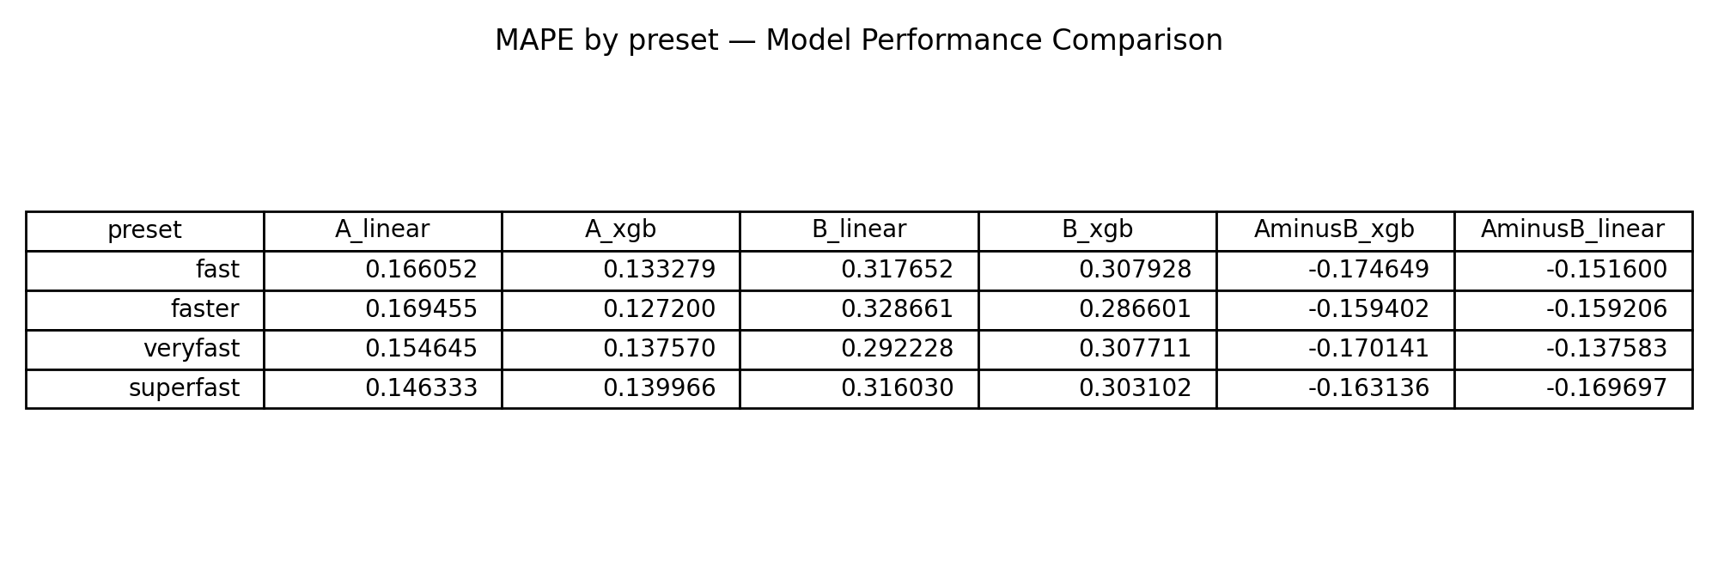
Energy Modeling based on PEs

